Slide 1
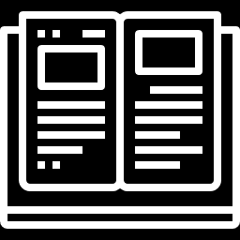
WINE QUALITY PREDICTION MODEL USING MACHINE LEARNING
MACHINE LEARNING THROUGH FOSS ML26 BATCH – B10

Slide 2

PROJECT - WINE QUALITY PREDICTION MODEL USING MACHINE LEARNING
SUBMITTED BY – JAYADEV P U
TEACHER IN CHARGE – Mr. DEEPU C
DATE – 09-02-2022
Notes:
Notes to presenter:
What is your purpose for sharing this reflection?
Is it at the end of a unit or project?
Are you sharing this reflection, at the attainment of a learning goal you set for yourself?
Is it at the end of a course?
State your purpose for the reflection or even the purpose of the learning experience or learning goal. Be clear and be specific in stating your purpose.

Slide 3






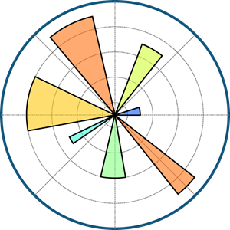



PROJECT DEPENDENCIES
LANGUAGE – PYTHON
LIBRARIES – NUMPY, PANDAS, SEABORN, MATPLOTLIB,
PILLOW, SKLEARN
ML ALGORITHM – RANDOM FOREST ALGORITHM
DEPLOYMENT TOOLS – GITHUB, STREAMLIT, HEROKU

Slide 4
CONTENTS
INTRODUCTION
WHAT WAS THE PROCESS ?
RANDOM FOREST CLASSIFIER ALGORITHM
DATASET
DATASET PROCESSING & EVALUATION
MODEL PREDICTION
MODEL BUILDING
MODEL DEPLOYMENT
PROJECT PICTURES
PROJECT DETAILS
CONCLUSION

Slide 5
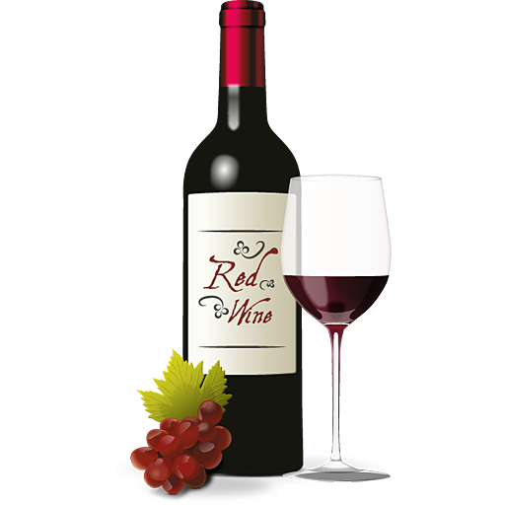
INTRODUCTION
The aim of this project is to predict the quality of wine on a scale of 0–10, i.e. GOOD QUALITY or BAD QUALITY, given a set of features as inputs. It also aims to get more accurate results in prediction. The ML model used here is RANDOM FOREST CLASSIFIER.

Slide 6


What was the process?
DATA SET & DATA PROCESSING
TRAIN & TEST DATA
01
04
02
03
RANDOM FOREST ALGORITHM
PREDICTION & DEPLOYMENT
Notes:
Notes to presenter:
What did you think at first?
What obstacles did you encounter along the way?
How did you overcome those obstacles?
What images can you add to support your process?
This SmartArt allows you add images and text to help outline your process. If a picture is worth a thousand words, then pictures and words should help you communicate this reflection on learning perfectly! You can always click on Insert>SmartArt to change this graphic or select the graphic and click on the Design contextual menu to change the colors.
Feel free to use more than one slide to reflect upon your process. It also helps to add some video of your process.

Slide 7
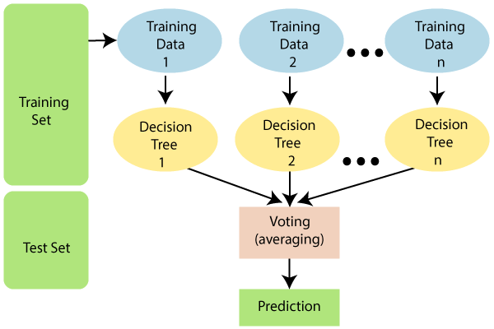
RANDOM FOREST ALGORITHM
Random Forest is a popular machine learning algorithm that belongs to the supervised learning technique. It can be used for both Classification and Regression problems in ML. It is based on the concept of ensemble learning, which is a process of combining multiple classifiers to solve a complex problem and to improve the performance of the model.

Slide 8
DATASET
Dataset/Source: https://www.kaggle.com/uciml/red-wine-quality-cortez-et-al-2009
Structured/Unstructured data: Structured Data in CSV format.
The red wine dataset contains 1599 instances and the white wine dataset contains 4898 instances. It have 11 input variables (based on physicochemical tests): fixed acidity, volatile acidity, citric acid, residual sugar, chlorides, free sulfur dioxide, total sulfur dioxide, density, pH, sulfates, alcohol, and 1 output variable (based on sensory data): quality. Sensory data is scaled in 11 quality classes from 0 to 10 (0-very bad to 10-very good).

Slide 9
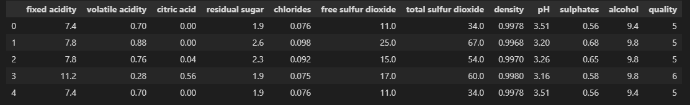
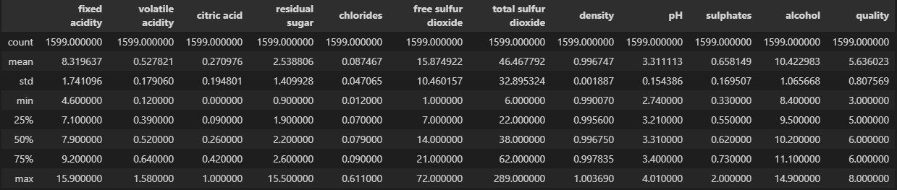

Slide 10
DATA PROCESSING AND EVALUATION
Splitting the dataset: We are keeping 20% of our dataset to treat it as unseen data and be able and test the performance of our models. We are splitting our dataset in a way such that all of the wine qualities are represented proportionally equally in both training and testing dataset. Other than that the selection is being done randomly with uniform distribution. The main purpose of the splitting data is to avoid overfitting. If overfitting occurs, the machine learning algorithm could perform exceptionally in the training dataset, but perform poorly in the testing dataset

Slide 11
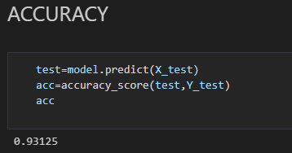
Evaluation:
The performance measurement is calculated and evaluate the techniques to detect the effectiveness and efficiency of the model.
Accuracy is the most widely used evaluation metric for most traditional applications.
Accuracy – Accuracy is defined as the ratio of correctly predicted observation to the total observation. The accuracy can be calculated easily by dividing the number of correct predictions by the total number of predictions
The model could able to achieve maximum accuracy using random forest of 93%.

Slide 12
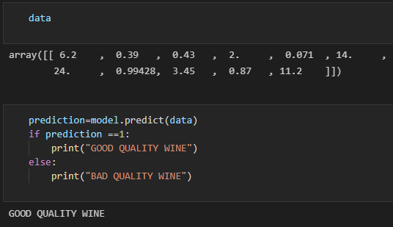
MODEL PREDICTION
After the processing of data, the model is implemented and then evaluated using test data, so to get some real outputs, some randomly chosen values are given to the model, and the model predicted the results so accurately.

Slide 13

BUILDING THE MODEL

Slide 14
MODEL DEPLOYMENT
The model is deployed using Streamlit and Heroku
Using streamlit we can deploy any machine learning model and any python project with ease and without worrying about the frontend. Streamlit is very user-friendly.
Heroku is a Platform as a Service (PaaS). It is a cloud platform where one can build, operate and run his/her applications in the cloud itself. Heroku, other than being a very extensive and helpful platform, offers many free plans when you create a new account on the platform. It is great for beginners who are just starting out and trying to learn model deployment to take advantage of the free plans to deploy their model on cloud.

Slide 15
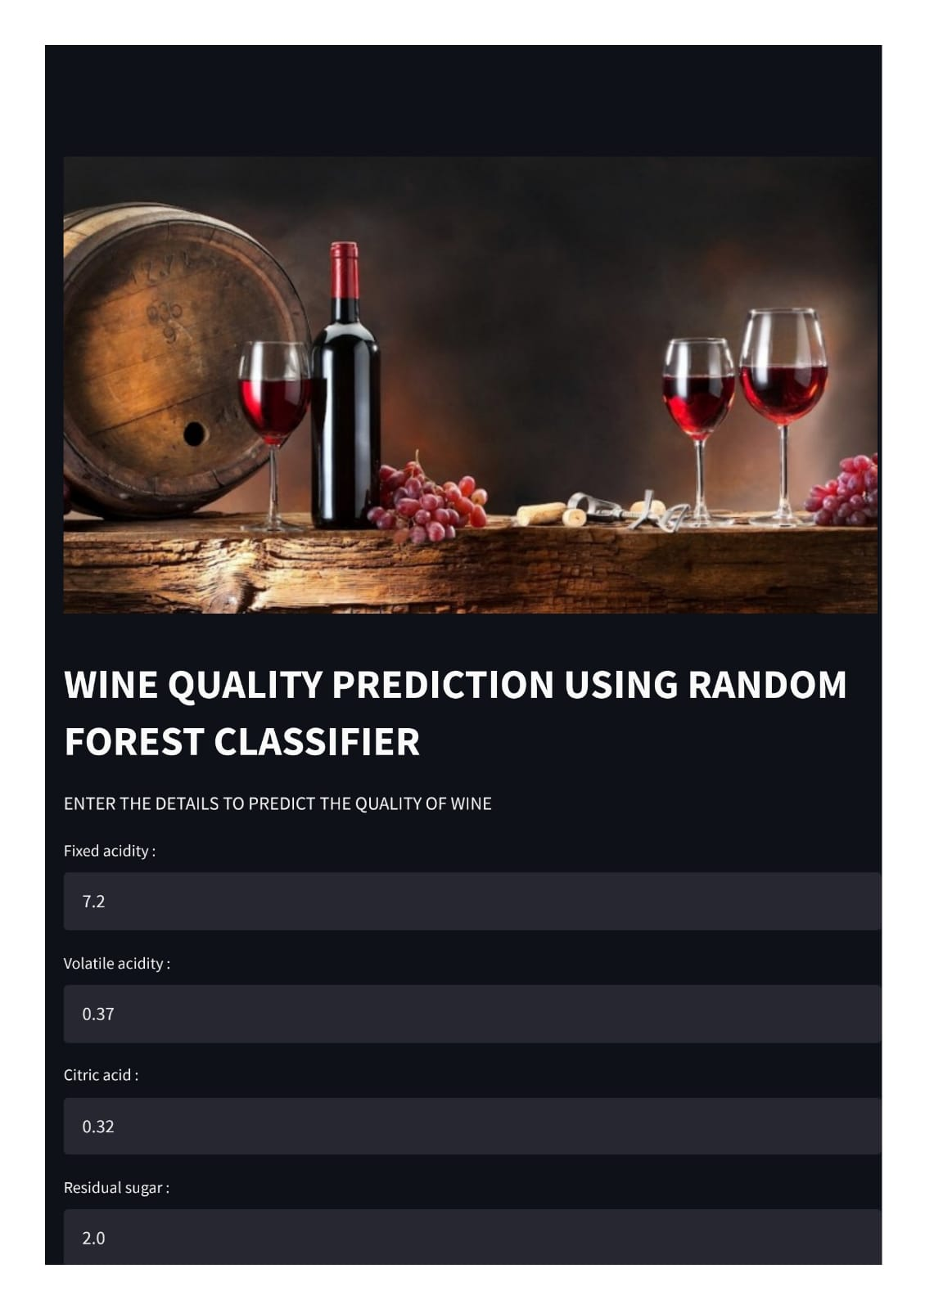
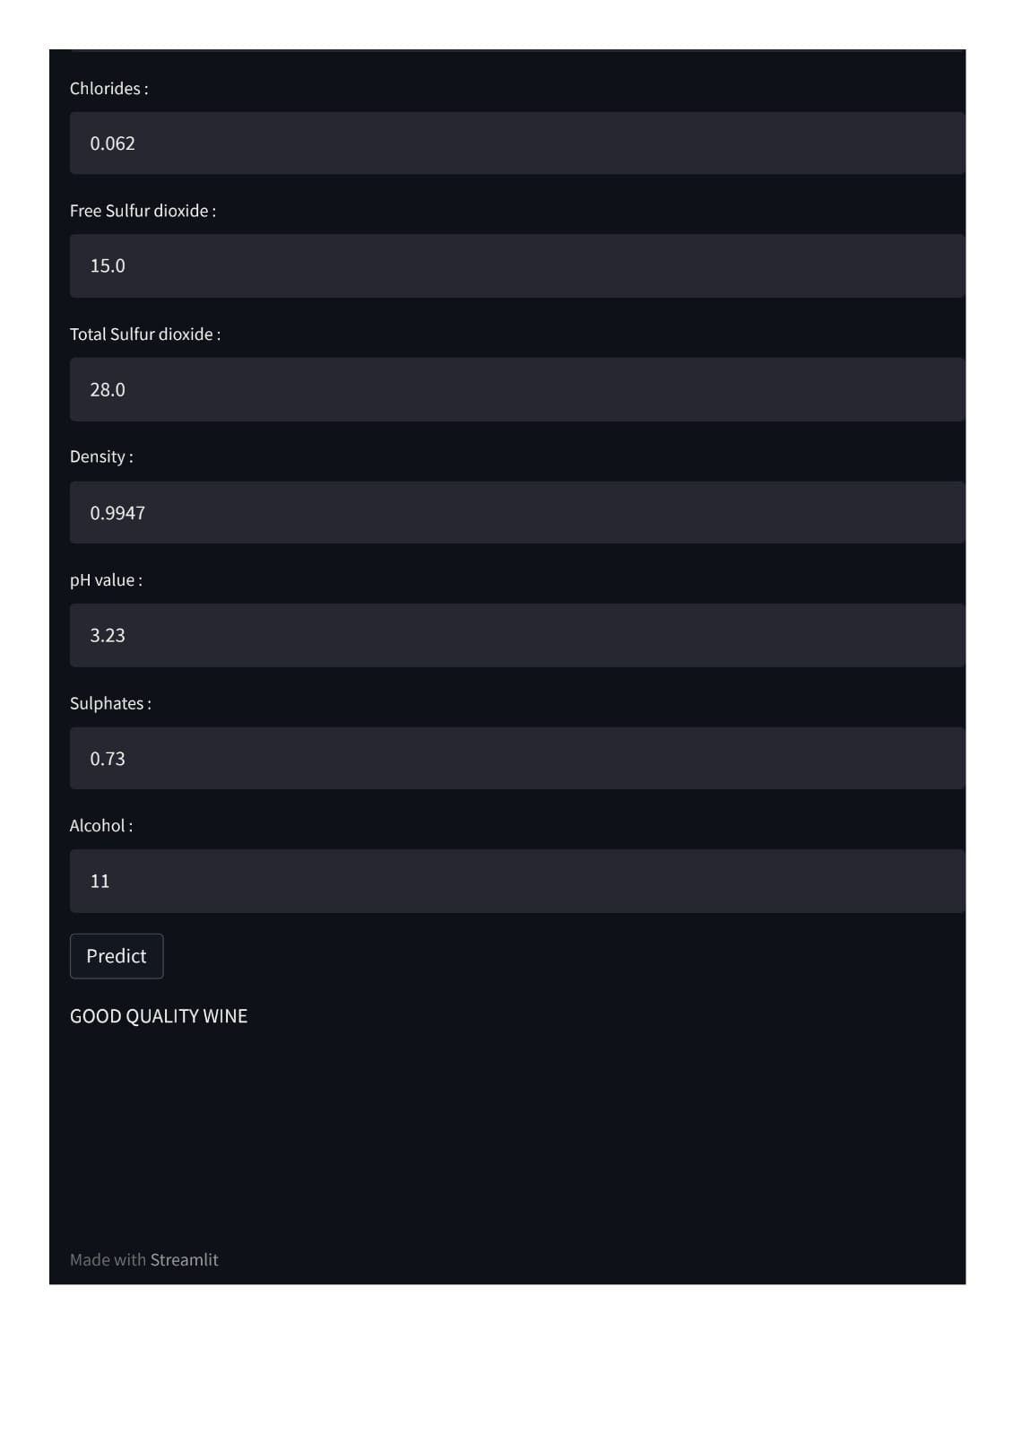

Slide 16
PROJECT DETAILS
Find the project on,
PROJECT LINK (HEROKU): https://winequalitypredictionusingml.herokuapp.com/
PROJECT REPO (GITHUB): https://github.com/Jayadev-3/Wine-Quality-Prediction-using-Machine-Learning.git
Dataset/Source: https://www.kaggle.com/uciml/red-wine-quality-cortez-et-al-2009

Slide 17
CONCLUSION
This PROJECT demonstrated the statistical analysis, can be used to analyse the parameters in the existing dataset to determine the wine quality. Based on various analysis, the wine quality can be predicted. We were able to achieve maximum accuracy using random forest of 93%. Therefore, in the classification algorithms by selecting the appropriate features and proper ML algorithms can improve the performance of the model.

Slide 18


